Slide 1


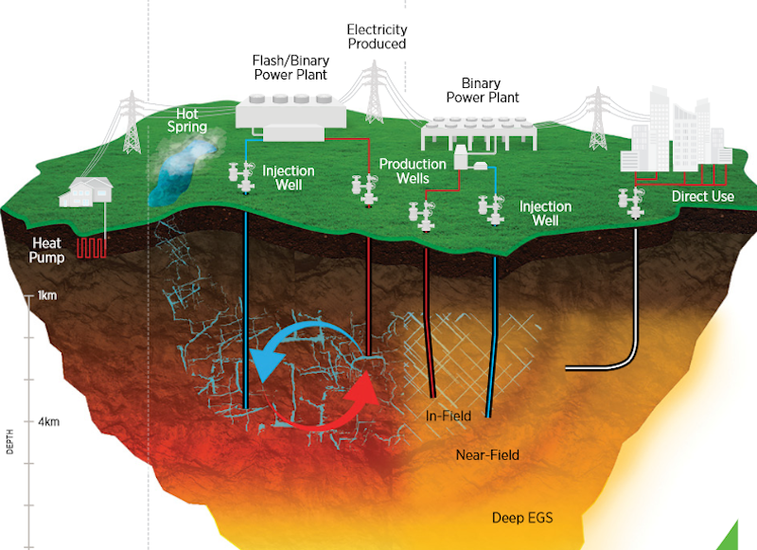
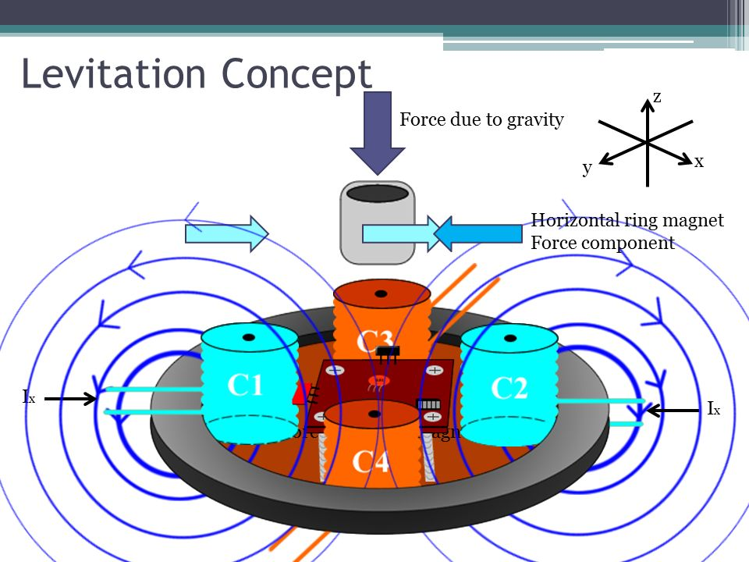
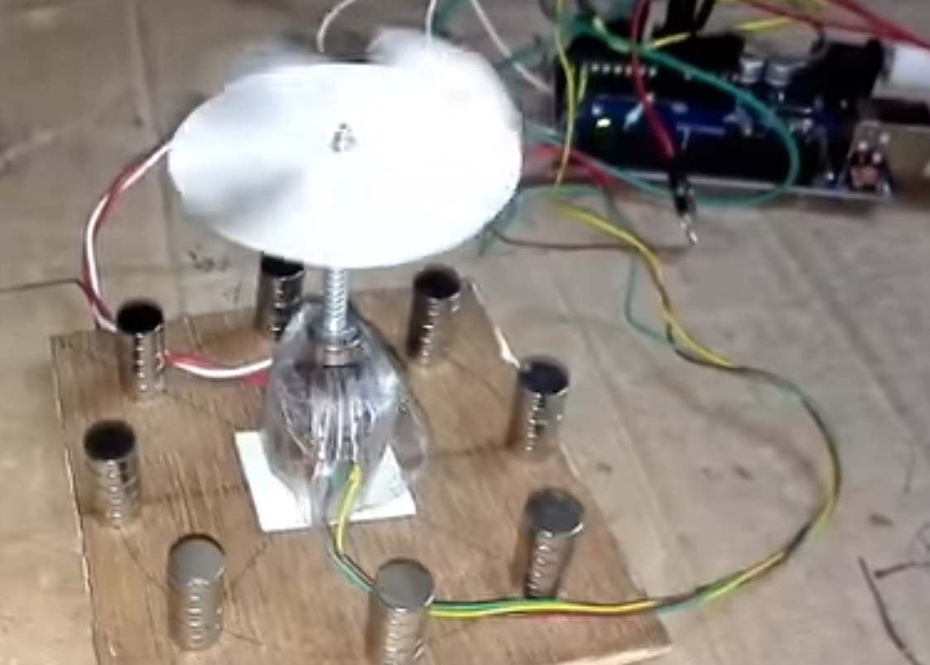
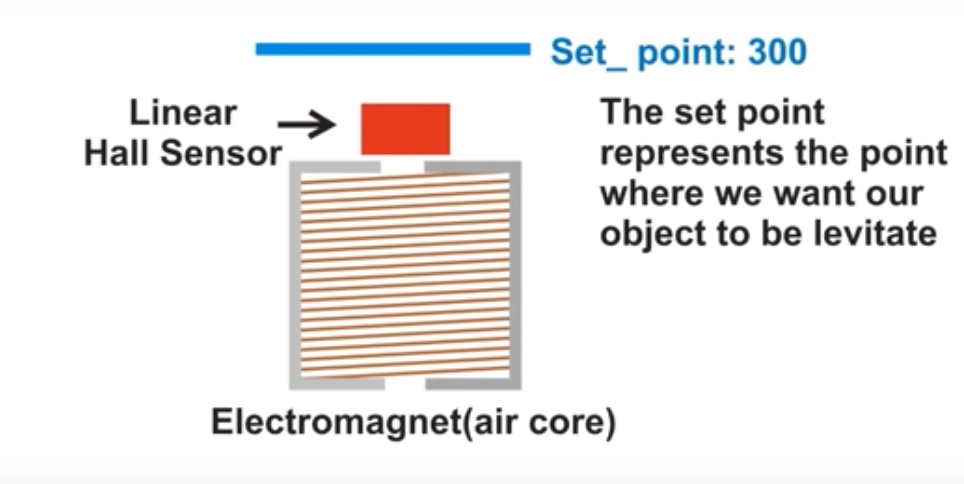
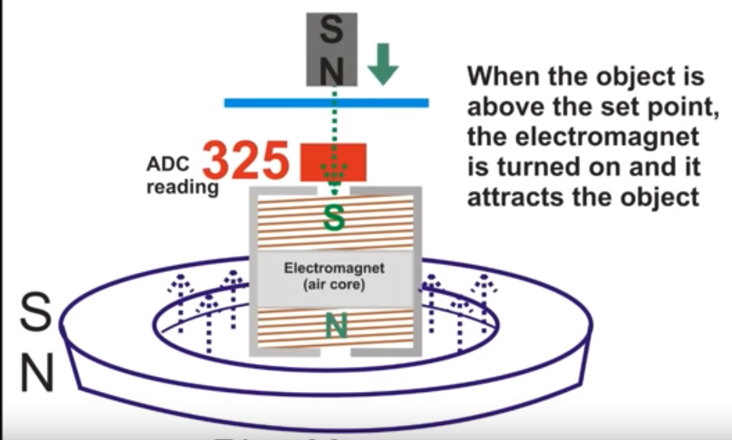
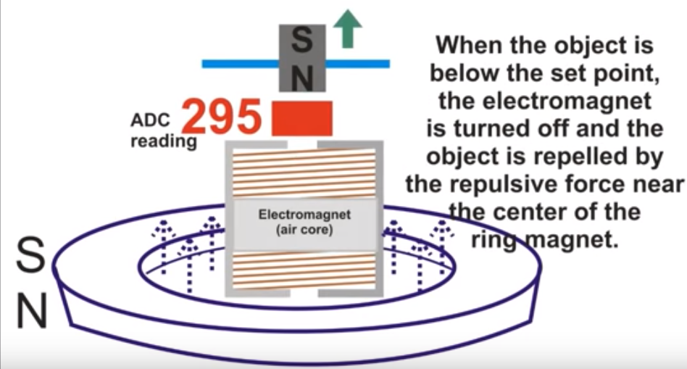
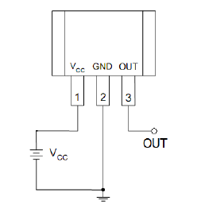
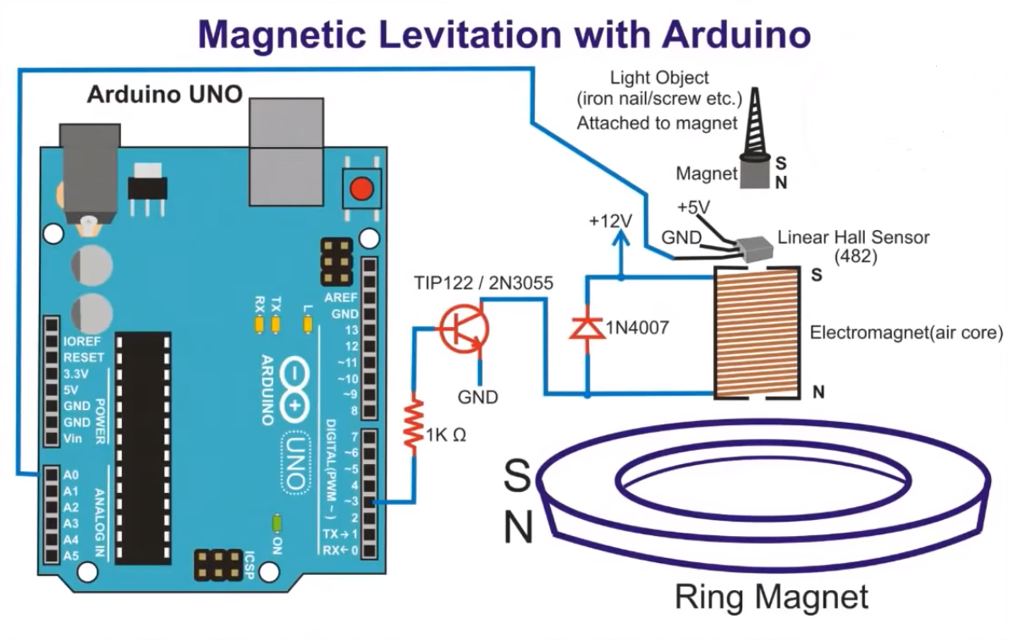
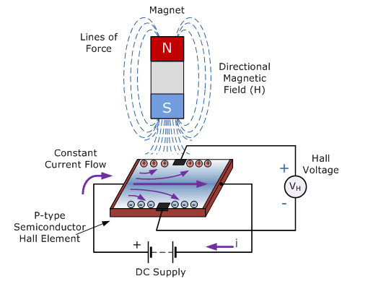
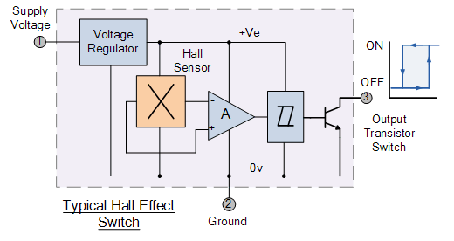

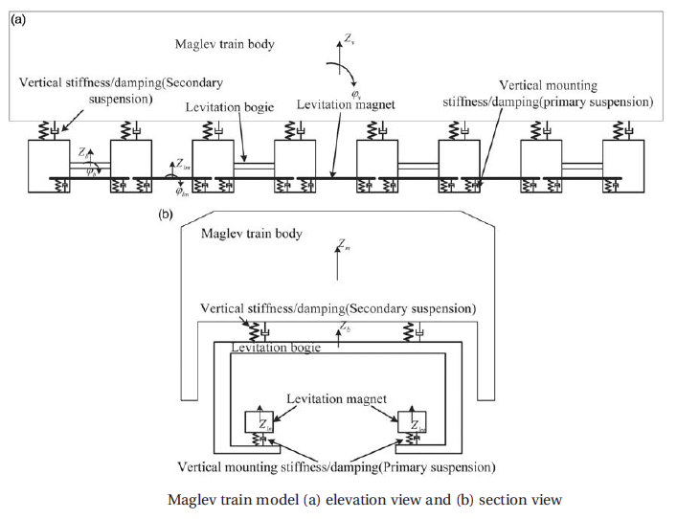
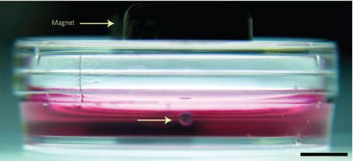
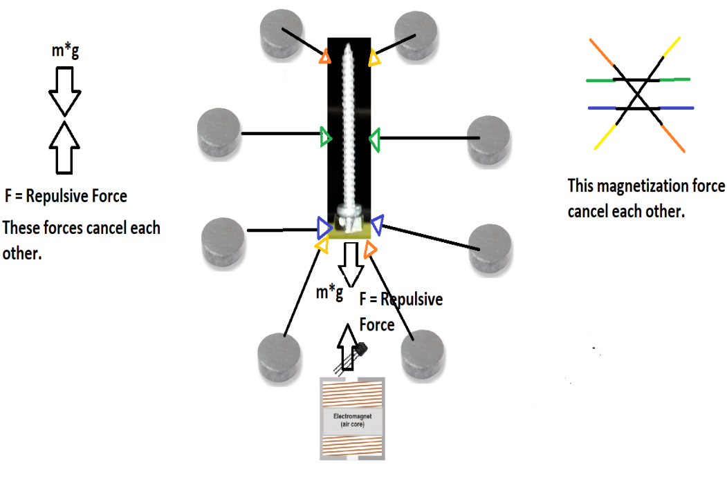



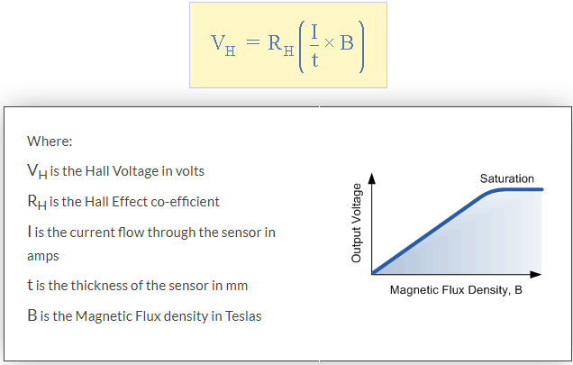
Repulsive Magnetic Levitation
Semih ÖZKAN¹, Muhammed Furkan TUNÇ², Muhammed Zahit KARAÇAM³, Hasan Basri GÜRDAL⁴
¹Marmara University, Istanbul, TURKEY, semihozkan555@gmail.com
²Marmara University, Istanbul, TURKEY, mfurkantunc@gmail.com
³Marmara University, Istanbul, TURKEY, mzahitkaracam@gmail.com
⁴Marmara University, Istanbul, TURKEY, hbgurdal@gmail.com
What is Geothermal Energy?
How Does It Work?
Geothermal energy is an important part of renewable for Turkey. It is usually used as a geothermal heating and produces %3 for Turkey’s electricty.
This energy is stored in rocks and fluids in the centre.
The rock and water in the Earth’s crust can reach heats of around 370 Celcious.
This energy, which exists in rocks and liquids, can also be found at shallow depths, a few miles below the Earth’s surface.
Geothermal energy can also be used in something. For example, it can be used for cooking and heating.
It can be used for electricty generation and other heating and cooling applications.
Geothermal energy can also be used in some areas. For example, it can be used for cooking and heating. It can be used for electricity generation and other heating and cooling applications.
In order to benefit from geothermal resources, wells are drilled to a certain depth in underground reservoirs.
These resources can be exploited through advanced geothermal systems that increase or create resources due to heat and water permeability.
One of the tasks of these geothermal sources is to run turbines connected to electric generators.
Geothermal power plants come in three different designs; dry steam, flash and binary.
The oldest type is dry steam, which takes steam directly from fractures in the ground to drive a turbine. Flash plants pull high pressure hot water from underground and mix it with cooler low pressure water.
This, in turn, creates steam that is used to drive a turbine. Binary plants use hot water passed through a secondary fluid that has a lower boiling point than water.
The secondary fluid is turned into vapour which drives a turbine. Most future geothermal power plants are expected to be binary plants.
Geothermal Energy[1]
Concept & Application
Figure 1. Levitation Concept.
Figure 2. Working state of Project.
Figure 3. Hall Sensor relation of the Magnet when set point is 300.
Figure 4. When the object above the set point.
Figure 5. When the object below the set point.
Linear Hall Effect Sensor
General View
Hall Effect Sensor Principles
Magnetic sensors convert magnetic or magnetically
encoded information into electrical signals for
processing by electronic circuits, and in the Sensors
and Transducers tutorials we looked at inductive
proximity sensors and the LDVT as well as
solenoid and relay output actuators.
Magnetic sensors are solid state devices that are becoming more and more popular because they can be used in many different types of application such as sensing position, velocity or directional movement. They are also a popular choice of sensor for the electronics designer due to their non-contact wear free operation, their low maintenance, robust design and as sealed Hall Effect devices are immune to vibration, dust and water.
Magnetic sensors are designed to respond to a wide range of positive and negative magnetic fields in a variety of different applications and one type of magnet sensor whose output signal is a function of magnetic field density around it is called the Hall Effect Sensor.
Hall Effect Sensors are devices which are activated by an external magnetic field. We know that a magnetic field has two important characteristics flux density, (B) and polarity (North and South Poles).
When the device is placed within a magnetic field, the magnetic flux lines exert a force on the semiconductor material which deflects the charge carriers, electrons and holes, to either side of the semiconductor slab. This movement of charge carriers is a result of the magnetic force they experience passing through the semiconductor material.
As these electrons and holes move side wards a potential difference is produced between the two sides of the semiconductor material by the build-up of these charge carriers. Then the movement of electrons through the semiconductor material is affected by the presence of an external magnetic field which is at right angles to it and this effect is greater in a flat rectangular shaped material [5].
Magnetic Levitation Engineering Applications [4]
Mathematical Model
Hall Effect Sensors are available with either linear or digital outputs. The output signal for linear (analogue) sensors is taken directly from the output of the operational amplifier with the output voltage being directly proportional to the magnetic field passing through the Hall sensor. This output Hall voltage is given as:
Maxwell Equations
Conclusion
References
[3]
[Equation 1]
In this project, our purpose is levitate the object using Maxwell Equation as a base principle of design, with respect to inputs that come from Linear Hall Effect Sensor to the Arduino UNO analog read pins. The Magnetic Flux Density is somewhat analogous to the Electric Field in that it can exert a force on a charged particle, although in a different way.
[1] https://slideplayer.com/slide/8926502/
[2] https://www.electronics-tutorials.ws/electromagnetism/hall-effect.html
[3] http://www.maxwells-equations.com/density/magnetic-flux.php
[4] A. El Hajjaji, M. Ouladsine, “Modeling and nonlinear control of magnetic levitation systems”, IEEE, Aug 2001
[5] K.A. Lilienkamp, “Low-cost magnetic levitation project kits for teaching feedback system design”, Proceedings of the 2004 American Control Conference
[Equation 2]
[Equation 3]
B: Magnetic Flux Density
H: Magnetic Field
E: Electric Field
: Permeability
F: Force
q: Charge [C]
v: Velocity
Copper permeability = 1.25 x 10⁻⁶, relative permeability = 0.999994
Lecturer:
Associate Professor Dr. Mustafa ONAT
monat@marmara.edu.tr

